Slide 1
Control Structures
Guoqiang Zhang
Reference book: “Introduction to Python Programming Course Notes”, Phil Spector, University of California Berkeley

Slide 2
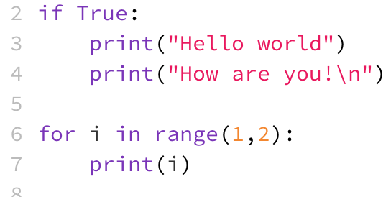
Control structures
Control structures allow a program to execute a code block only under certain conditions, thus providing more flexibility in the program design.
Selection
A code block is executed only if a certain condition holds (e.g., if statement)
Repetition
A code block is executed repeatedly as long as a certain condition holds (e.g., for loop)
Python uses indention to identify the code block for each control structure
C language uses {} to identify the code block for each control structure
Matlab identifies the code block within, for example, “if-end” and “for-end” keywords.
A piece of python code

Slide 3
Conditional Operators (1)
Comparison operators
Remarks:
== Equality
> Greater than
>= Greater than or equal to
in membership in sequence
not in Lack of membership
!= Non-equality
< Less than
<= Less than or equal to
is Equivalence
not is Non-equivalence
Numeric values are false if they are equal to zero, and true otherwise
Sequence objects (like strings and lists) are false if they contain no elements
A dictionary is false if it has no keys or values
The special python value ‘None’ also evaluates to false

Slide 4
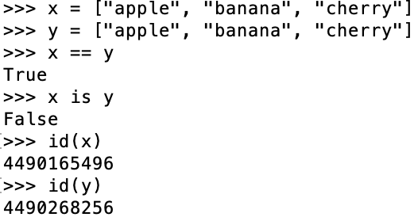
Conditional Operators (2)
Difference between == and is
The is keyword tests if two variables refer to the same object.
The == operator tests if two variables are equal.
Remark: The built-in function id() returns an identity of an object, which is a unique integer.

Slide 5
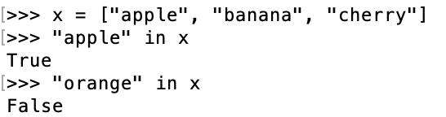
Conditional Operators (3)
The in keyword
The in keyword is used to check if a value is present in a sequence (list, range, string etc.).

Slide 6
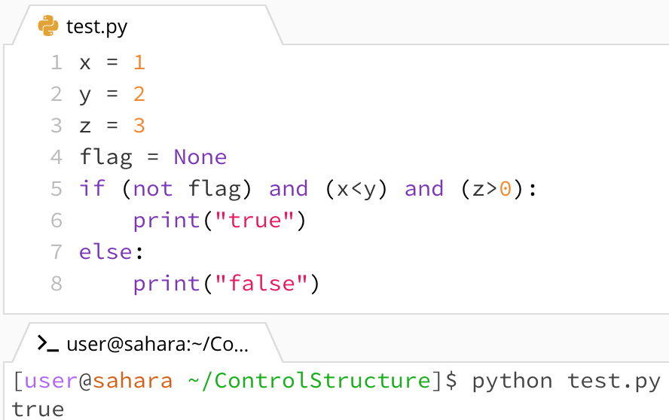
Conditional Operators (4)
Logical operators
Remarks:
Operators Meaning Example
and True if both the operands are true x and y
or True if either of the operands is true x or y
not True if operand is false not x
Logical operators can be used to combine results of multiple comparisons
For a complicated expression, use parentheses () to make sure python understand your intention.
Similar to C language, for efficiency, python evaluates a logical expression (from left to right) until it can determine whether or not the expression is true.
A piece of python code

Slide 7
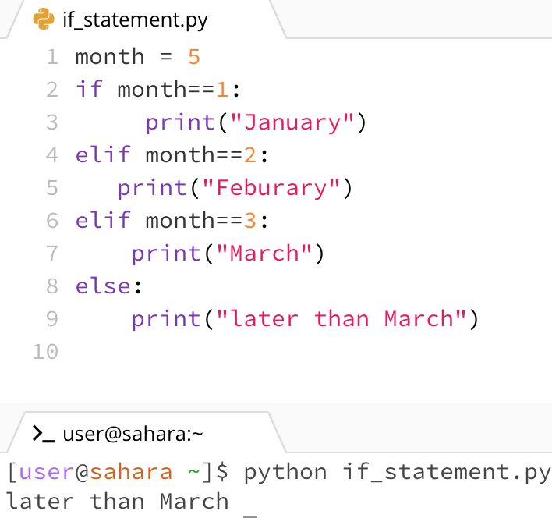

IF Statement
Syntax:
Remarks:
if expression :
statement (s)
elif expression :
statement (s)
$⋮$
else:
statemente (s)
There MUST be a colon at the very end of each logic expression following the keywords “if”, and “elif”.
If needed, nested if statements can be used.
A piece of python code

Slide 8
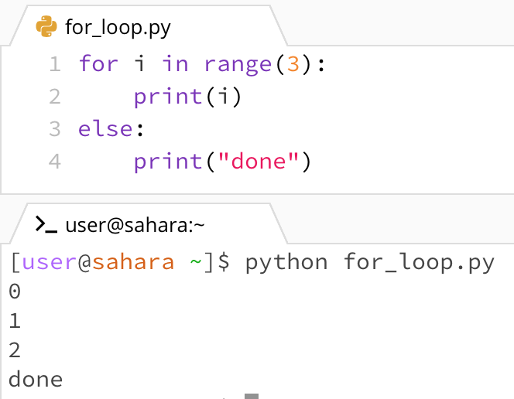
For loop
Syntax:
Remarks:
for var in sequence :
statement (s)
else:
statement (s)
There MUST be a colon at the very end of the expression following the keyword “for”.
The else statement is optional.
Example 1

Slide 9
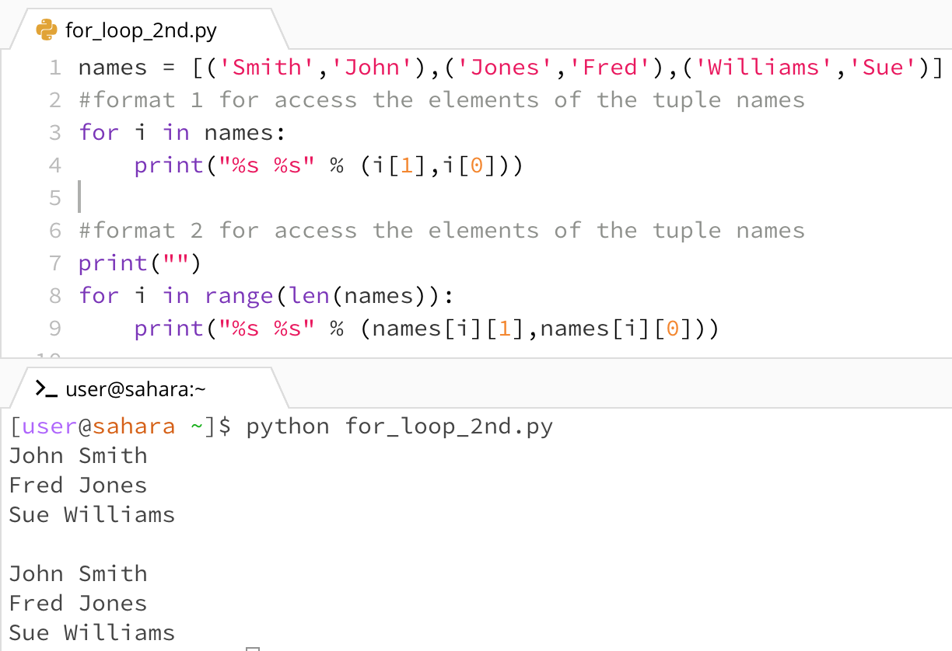
For loop
Example 2
Syntax:
Remarks:
for var in sequence :
statement (s)
else:
statement (s)
There MUST be a colon at the very end of the expression following the keyword “for”.
The else statement is optional.

Slide 10
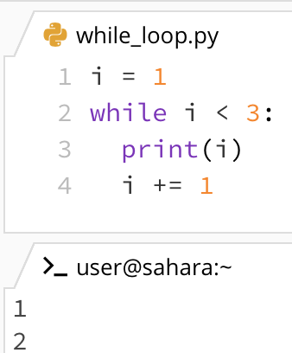
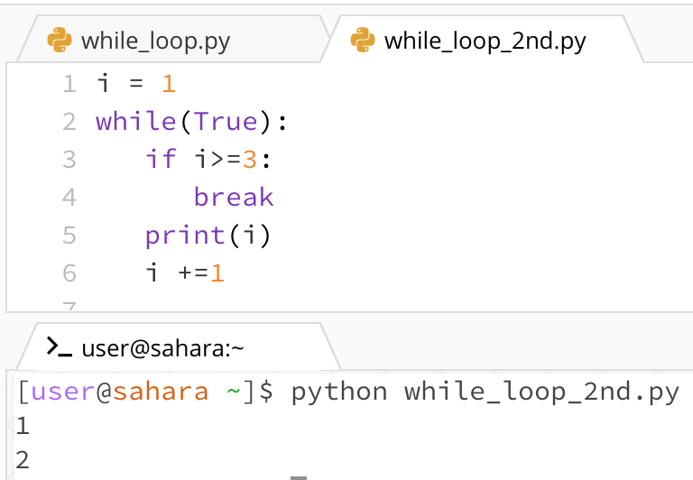
while loop
Syntax:
Remarks:
while expression :
statement (s)
else:
statements
There MUST be a colon at the very end of the expression following the keyword “while”.
The else statement is optional.

Slide 11
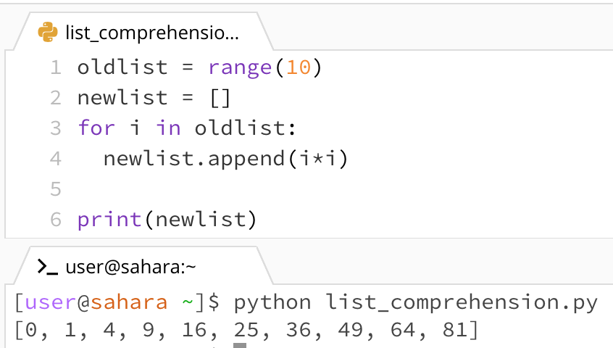
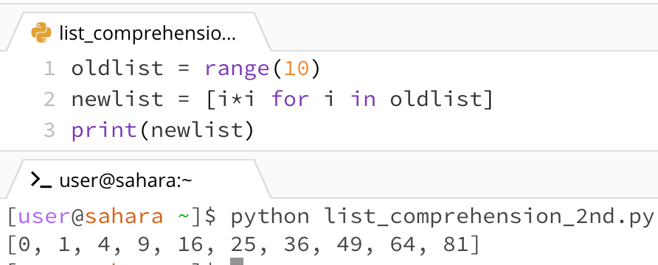
List Comprehensions
Usage:
Construct a new list by accessing one or more old lists
More compact than using the for loop statement
Syntax:
[expression for var1 in seq1 if condition1 for var2 in seq2 if condition2 ...]
Code using for-loop
Code using list comprehensions

Slide 12
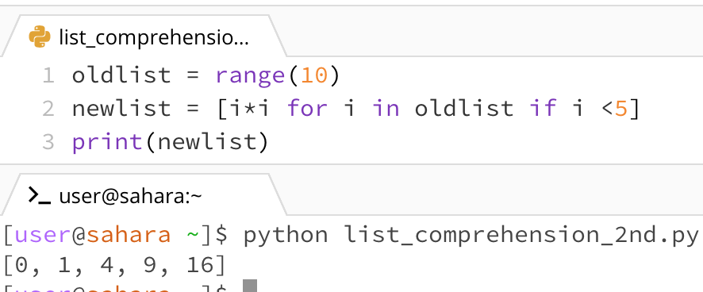
List Comprehensions
Usage:
Construct a new list by accessing one or more old lists
More compact than using the for loop statement
Syntax:
The if-clause helps to select desirable elements in a list
[expression for var1 in seq1 if condition1 for var2 in seq2 if condition2 ...]

Slide 13
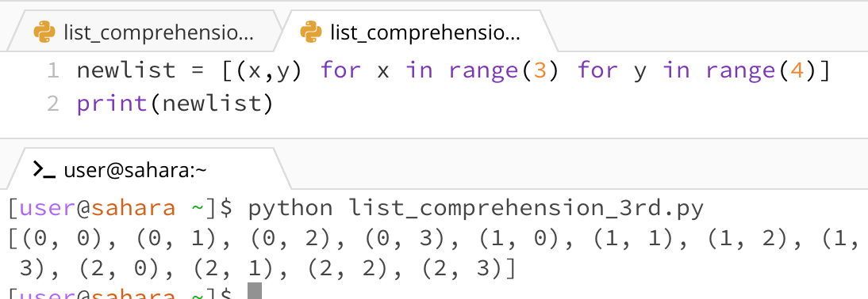
List Comprehensions
Usage:
Construct a new list by accessing one or more old lists
More compact than using the for loop statement
Syntax:
More than one for-clause
[expression for var1 in seq1 if condition1 for var2 in seq2 if condition2 ...]

Slide 14
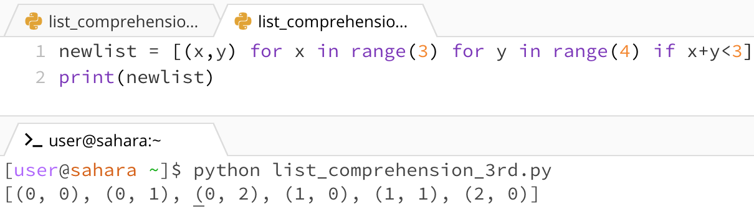
List Comprehensions
Usage:
Construct a new list by access one or more old lists
More compact than using the for loop statement
Syntax:
If clause in more than one for-clause
[expression for var1 in seq1 if condition1 for var2 in seq2 if condition2 ...]

Slide 15
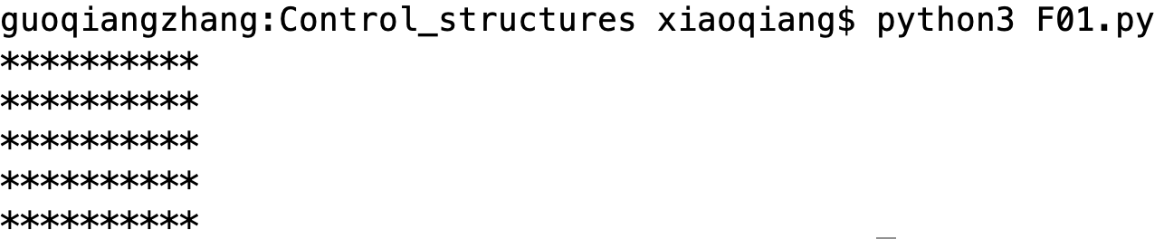
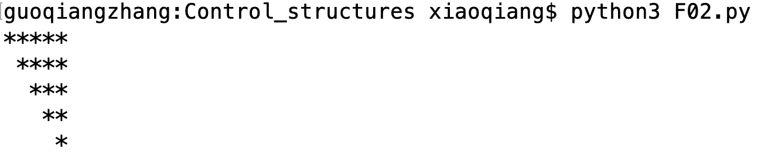
Exercises (1)
Write a python program to print a rectangle of 5*10 stars
Write a python program to print a lower triangle of stars

Slide 16
Exercises (2)
Write a python program to filter out the strings with capital letters in a list of strings (see F03.py)
Suppose the list of strings is: list_str = ["I", "am", "new", "to", "Python"]
The final list should be [“I”, “Python”]

